Slide 1
Task 1 Digital Solutions: Achieving Distinction Level in Website Development

Slide 2
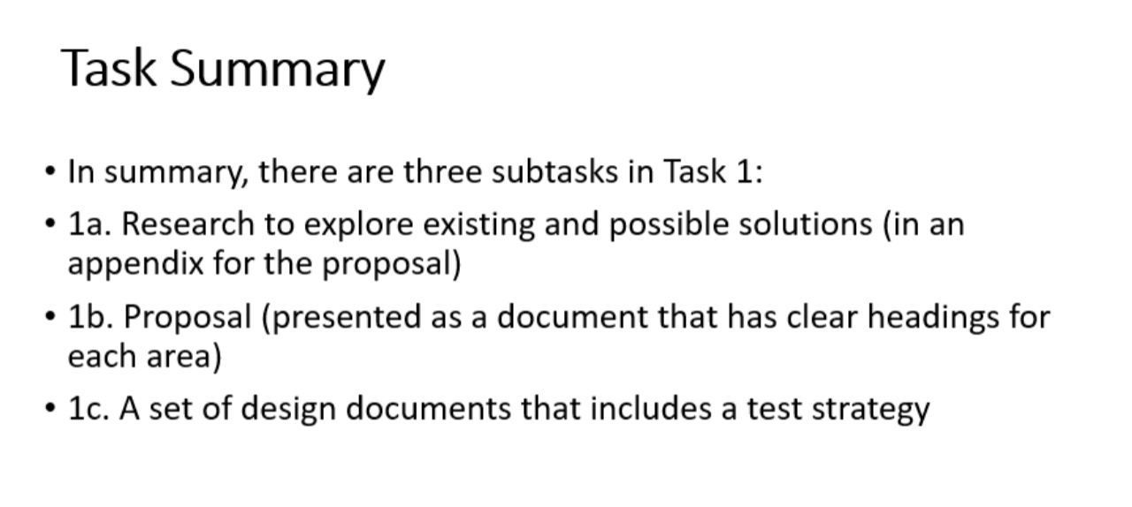

Slide 3
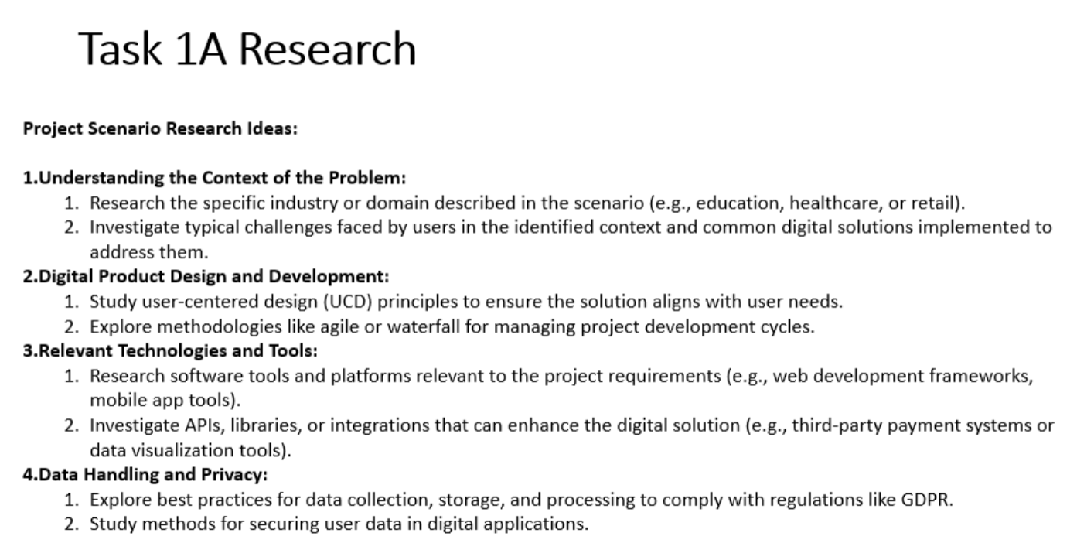

Slide 4
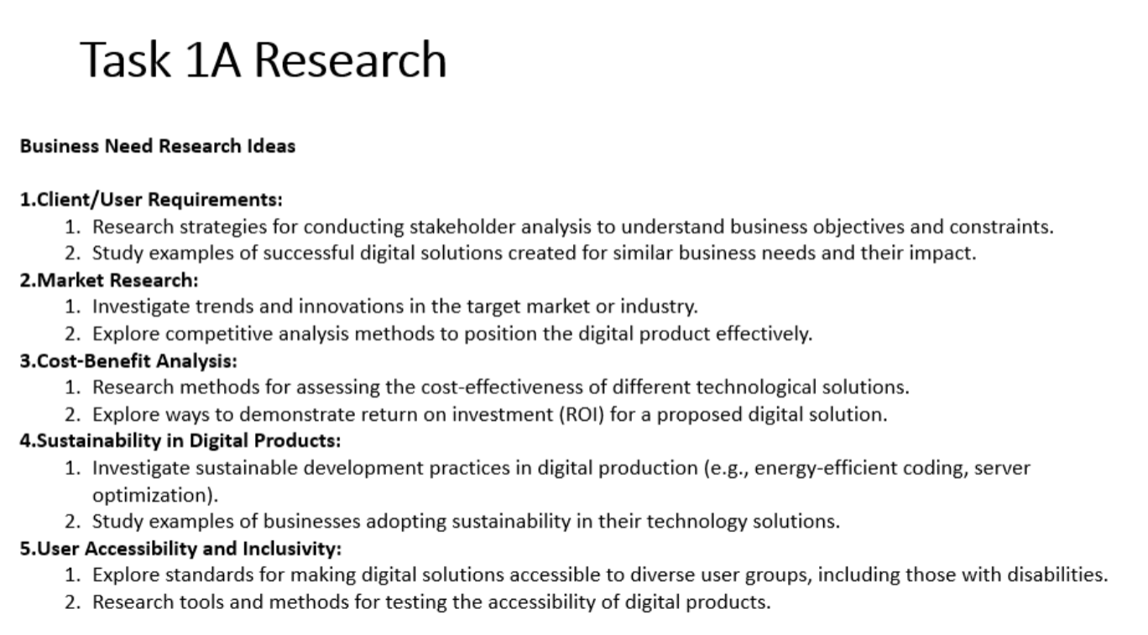

Slide 5
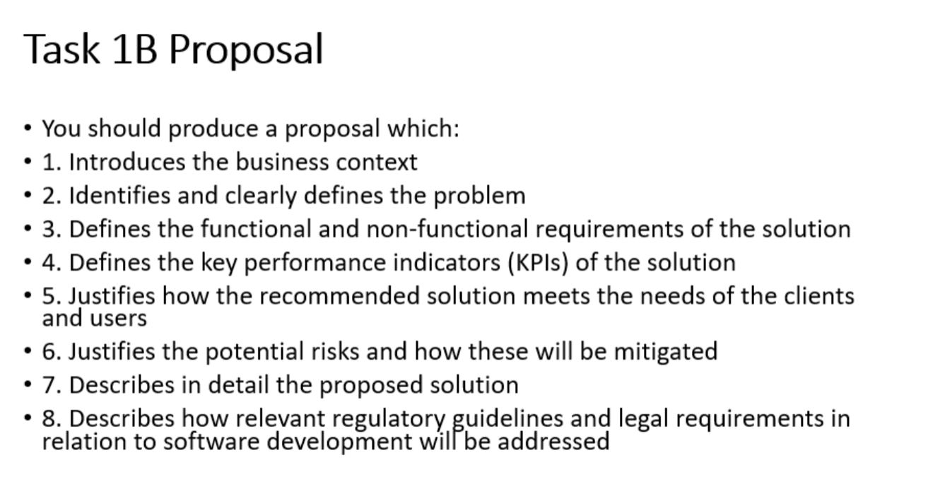

Slide 6
Project Overview
Comprehensive website development for RZA Adventures
Focus on educational visits and booking system
Key components: proposal, implementation, testing, and evaluation
Target audience: Zoo visitors and educational groups

Slide 7
The Proposal - Key Elements
Functional requirements
Non-functional requirements
System decomposition
Risk assessment and mitigation
Client and user needs analysis

Slide 8
Functional Requirements Breakdown
Homepage with navigation and carousel
About page with static content
Educational visits section
Booking system with dual functionality
User account management
Data validation processes

Slide 9
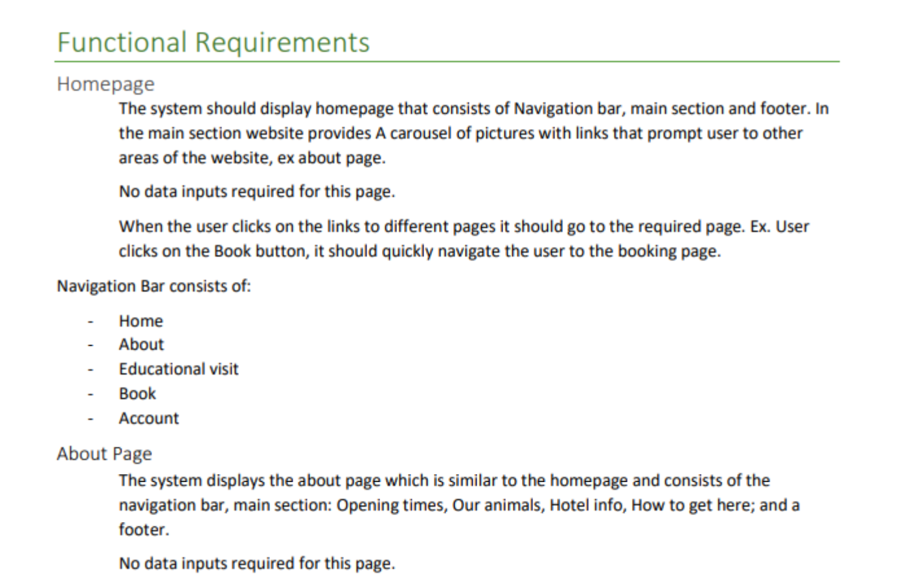
The homepage section specifies required elements, such as the navigation bar, main section, footer, and a carousel of pictures with links. User interactions are defined, stating that no data input is required and detailing the behaviours when users click links
The navigation bar content is listed clearly for easy implementation. Subsequent pages like the About Page, Educational Visits Page, and Booking System are described with precise requirements. For instance, the About and Educational Visits pages require no data input, indicating their static nature.

Slide 10
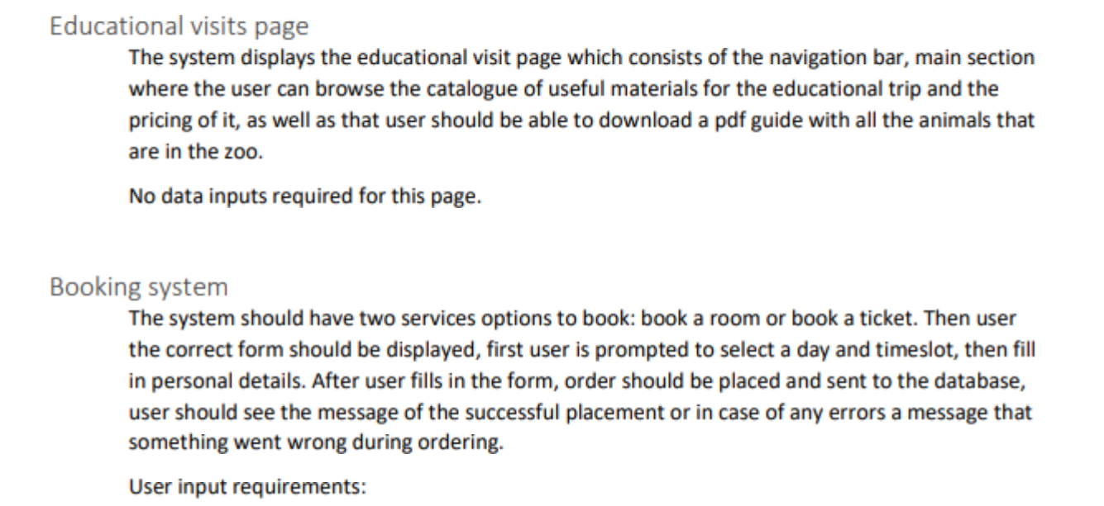
The Booking System section outlines two service options (booking a room or ticket) and the steps of the booking process. User input requirements are clearly stated, including selecting a day and timeslot, filling in personal details, and providing feedback upon order placement or errors. This ensures the booking system's functionality is well understood

Slide 11
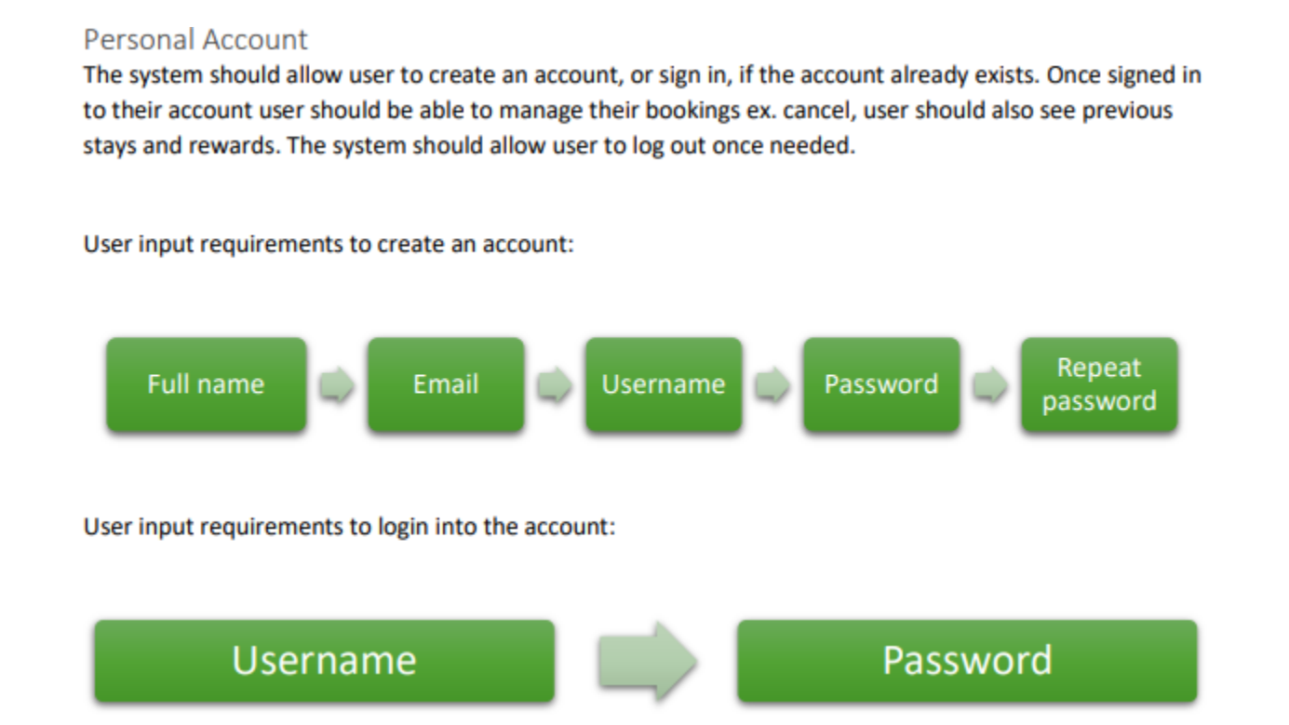

Slide 12
Non-Functional Requirements
Security: Data validation, secure cookies, SHA256 encryption
Maintainability: Clear coding practices, naming conventions
Performance: 2-6 second load time, 100ms latency
Usability: WCAG compliance, user-friendly interface

Slide 13
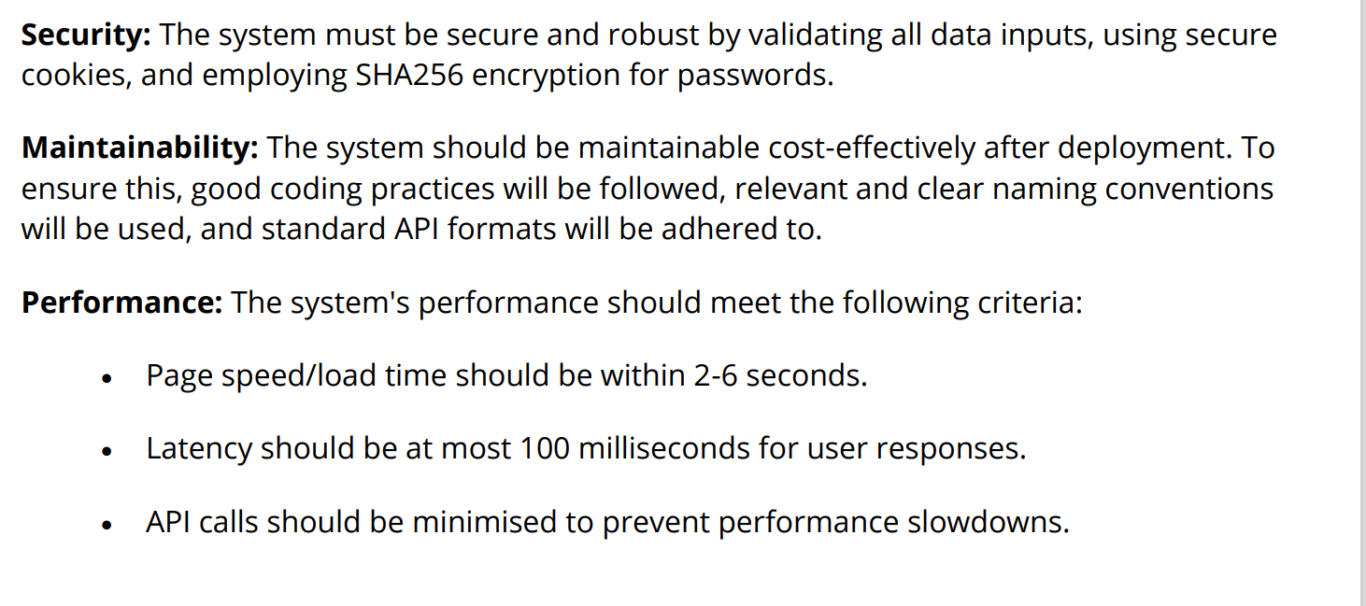
Non-Functional Requirements

Slide 14
System Decomposition
Home section: Navigation, carousel, footer
About Us: Opening times, animal info, directions
Educational Trips: Safety info, materials catalog
Booking: Ticket and hotel reservations
Account Management: Sign-up, login, rewards

Slide 15
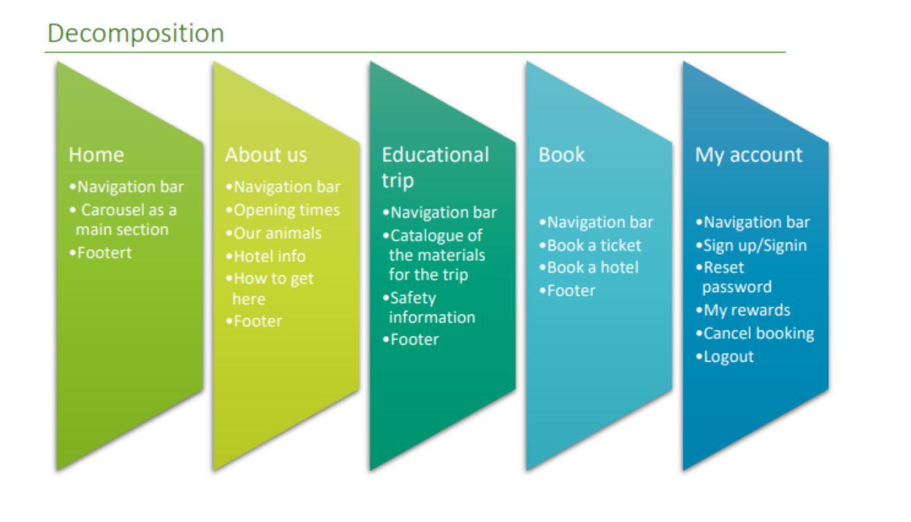
The Book section features a navigation bar, options to book a ticket or hotel, and a footer. This clear setup facilitates efficient reservations and enhances functionality and user experience.
The About Us section lists opening times, animal information, hotel details, and directions, with a navigation bar and footer for consistency. This thorough detailing ensures quick access to critical information.
My Account section offers sign-up/sign-in, password reset, reward management, booking cancellation, and logout options, with a navigation bar. This comprehensive setup ensures seamless account management.
. The Educational Trip section includes a navigation bar, a catalogue of trip materials, safety information, and a footer. This structured section provides relevant content for educational visits and demonstrates anticipation of user needs
The Home section includes a navigation bar, a carousel as the main feature, and a footer. This setup ensures easy navigation and an engaging user experience

Slide 16
Key Performance Indicators
Customer sign-ups
Monthly website usage
Session duration
Page load times
Daily user visits
Bounce rate analysis

Slide 17
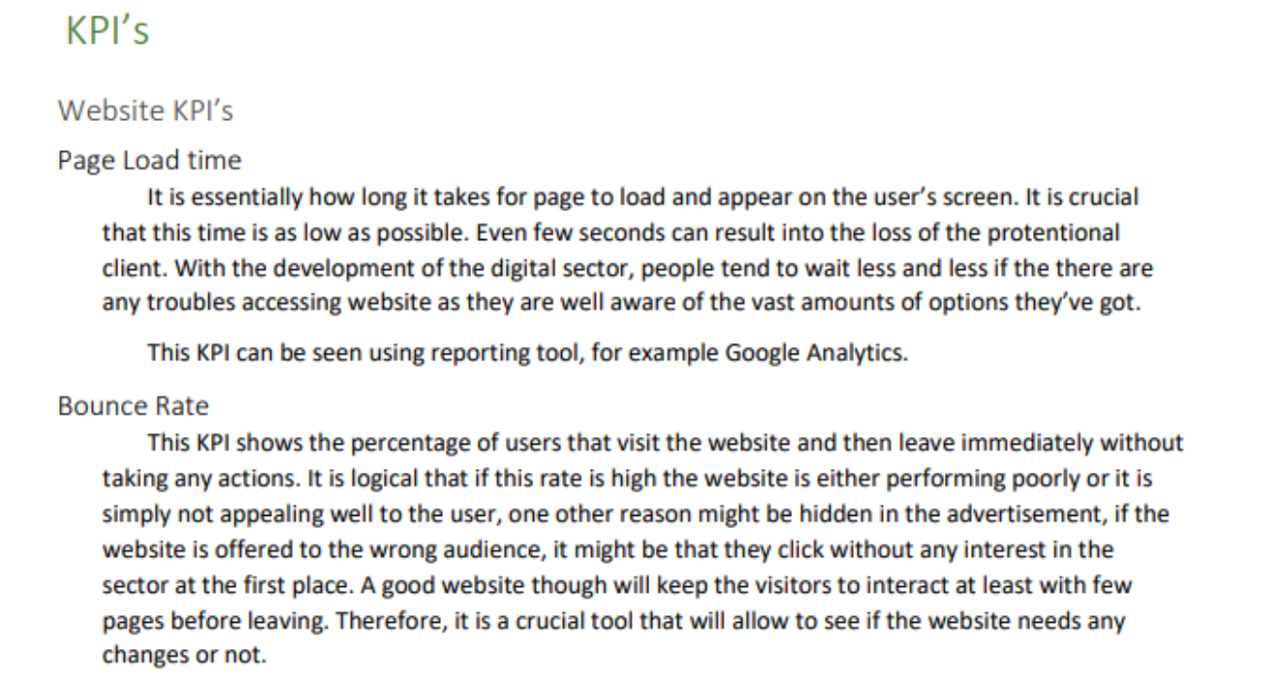
Comprehensive List of KPIs:
o The student has identified various KPIs crucial for assessing a website's performance. These KPIs cover multiple aspects of user interaction, operational efficiency, and overall effectiveness

Slide 18
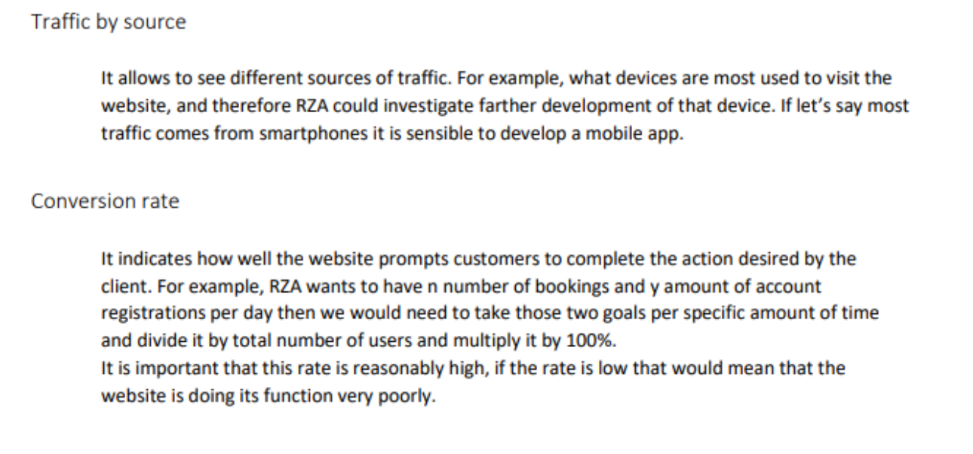

Slide 19
Comprehensive List of KPIs:
o The student has identified various KPIs crucial for assessing a website's performance. These KPIs cover multiple aspects of user interaction, operational efficiency, and overall effectiveness.
Clarity and Relevance:
o The KPIs listed are clearly defined and relevant to the context of a website's performance. Metrics such as the number of customers signed up, website usage per month, and session duration are essential for understanding user engagement and satisfaction.

Slide 20
3. Detail and Explanation:
o The student has provided detailed explanations for some KPIs, particularly for average session duration, page load and response time, daily user visits, and bounce rate. These explanations help us understand each metric's importance and how they contribute to the website's overall performance.
o For example, the explanation of average session duration highlights its significance in providing valuable information to users, and the discussion on page load time emphasises its impact on user experience and search engine rankings.
o Technical Accuracy:
o The technical language is mostly accurate, and the student has communicated complex concepts clearly and understandably.
o However, there are a few typographical errors that need correction. For instance, "each week" should be "each week," and "How many book reservations" should be "How many reservations for the on-site hotel per month." The "bounce rate" should also be corrected to "bounce rate."

Slide 21
4. Evaluation of Importance:
o The student has effectively evaluated the importance of each KPI. For instance, the importance of page load and response time in enhancing user experience and improving search engine rankings is well articulated.
Similarly, the significance of bounce rate in measuring user engagement is clearly explained.

Slide 22
Website Benefits
Inclusive solution for all users
Quick and easy booking system
Educational materials access
Comprehensive information blocks
Personalized user experience
Loyalty program integration

Slide 23
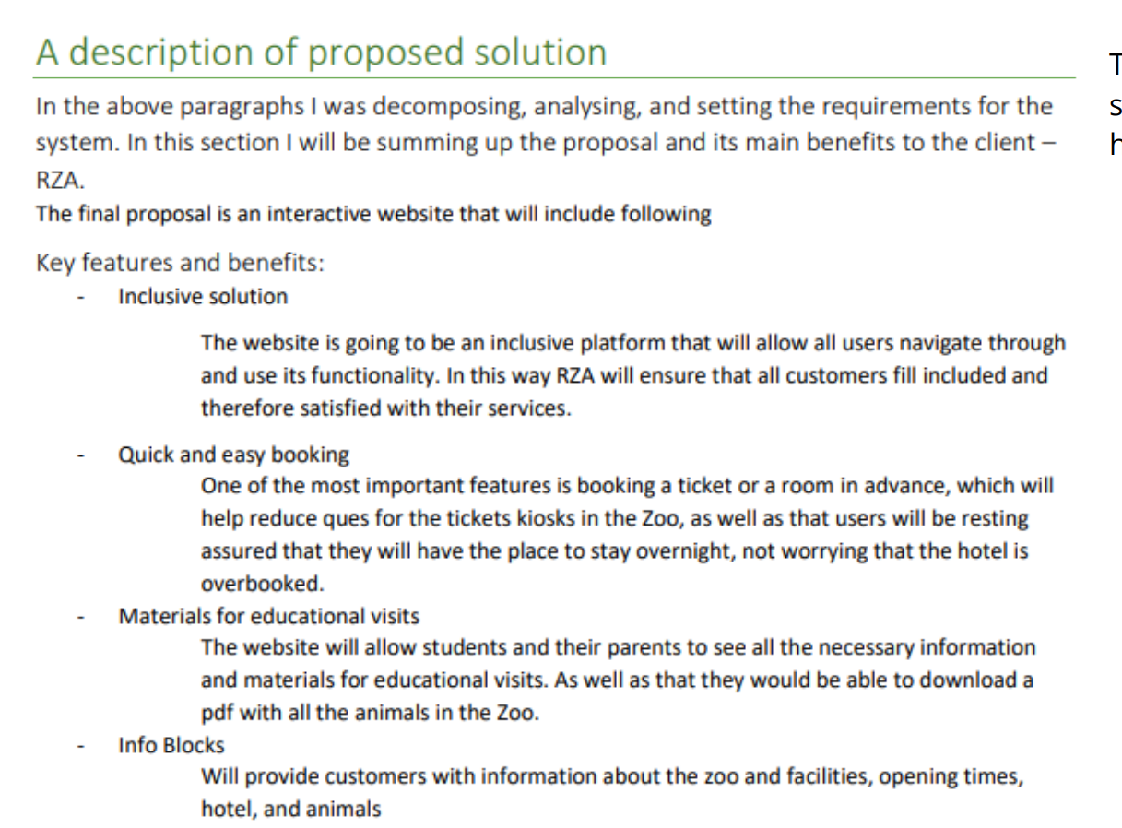
The Inclusive Solution ensures all users can navigate and use the website’s functionality, demonstrating a keen understanding of accessibility and customer satisfaction.
The Quick and Easy Booking feature highlights advance ticket and room booking, reducing queues and providing users with peace of mind, reflecting a user-centric design approach.
The Info Blocks provide comprehensive information about the zoo, facilities, opening times, hotel, and animals, showing attention to detail and enhancing the user experience.
The Info Blocks provide comprehensive information about the zoo, facilities, opening times, hotel, and animals, showing attention to detail and enhancing the user experience.

Slide 24
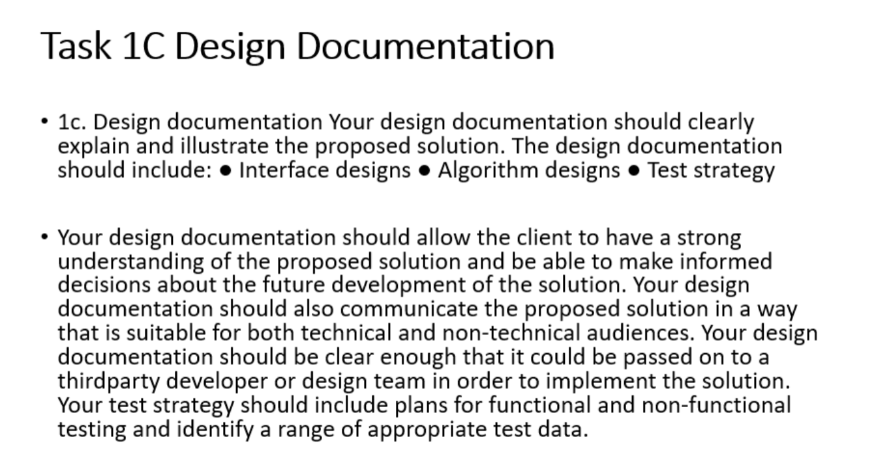

Slide 25
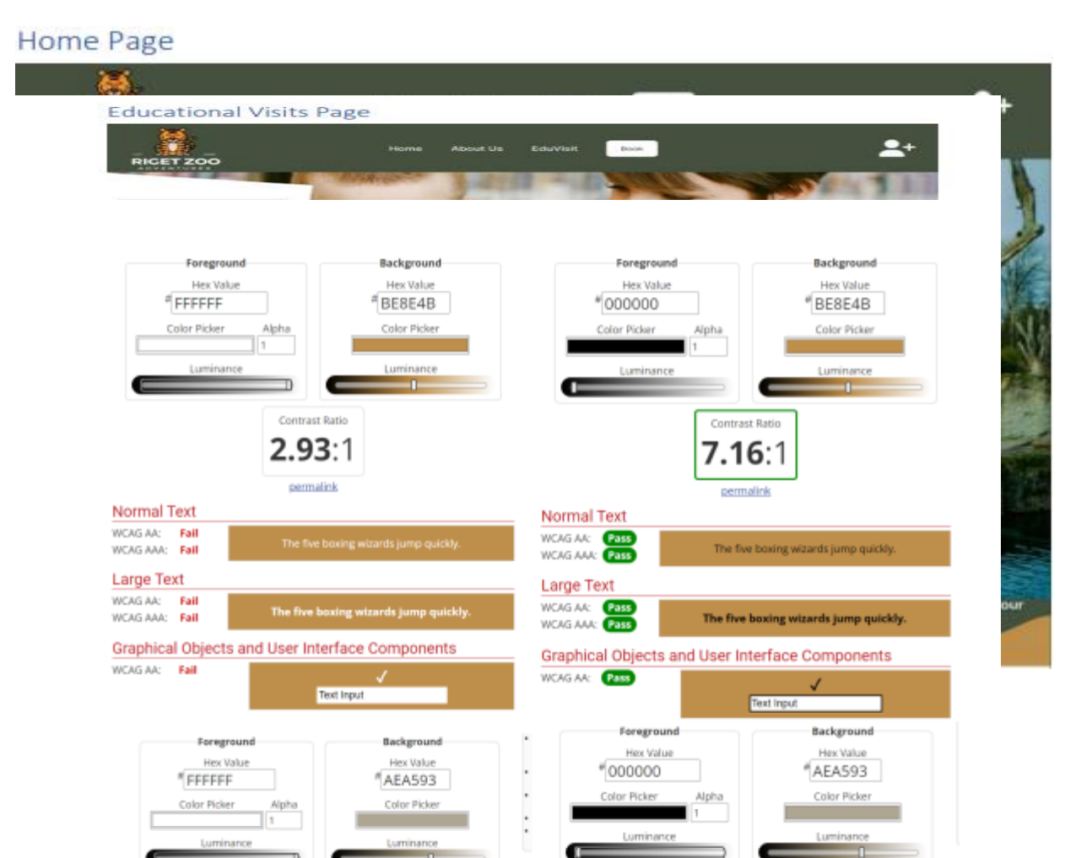
Educational Visits Page Design
Clear visual hierarchy
Color-coded resource sections
Responsive design elements
Interactive features
Accessibility considerations
User feedback integration
Go to WCAG
WebAIM: Contrast Checker
Web Accessibility Evaluation Tools List | Web Accessibility Initiative (WAI) | W3C

Slide 26
Visually appealing and well structured,
Demonstrating a solid understanding of user interface principles. The clean, modern layout balances images and text effectively, with a large header image featuring a child and an adult that clearly conveys the page's educational focus.
Content is organised into categories
Video, Audio, and Facts File, using colourcoded boxes that enhance both visual appeal and usability.
Navigation is straightforward,
Clear top bar and footer links to essential sections like About Us, Educational Visits, 11 and Book.

Slide 27
Call-to-action
For booking educational trips is prominent and well-designed, providing concise information on pricing and features to encourage user engagement.
Responsive design
Adapting well to various screen sizes to ensure a good user experience on both desktop and mobile devices

Slide 28
Distinction
Interactive Enhancements
Elements such as hover effects on resource boxes could improve user engagement, while brief descriptions or previews on these boxes would help users understand the content before clicking
Accessibility
Ensuring all images have descriptive alt text for screen readers and providing options to adjust font size and contrast would improve accessibility.
User satisfaction
Including user reviews or testimonials from previous visits and a Frequently Asked Questions section could build trust and preemptively address common queries, enhancing user satisfaction

Slide 29
Performance considerations
Additionally, optimising images and resources for quick loading times would improve performance, and
Consistent theme
Branding throughout the page would reinforce brand identity. These improvements would enhance the overall functionality, user-friendliness, and appeal of the design.
Complex Structure
Considered the complex structure of the website and page specifications such as background colour, text sizes and type. You will notice that the student has provided layouts, visual hierarchy, and standard convention.
Visual Designs
Consideration of the typical conventions. For example, how would the Web developer build the website without knowing text sizes, colours and other descriptive features

Slide 30
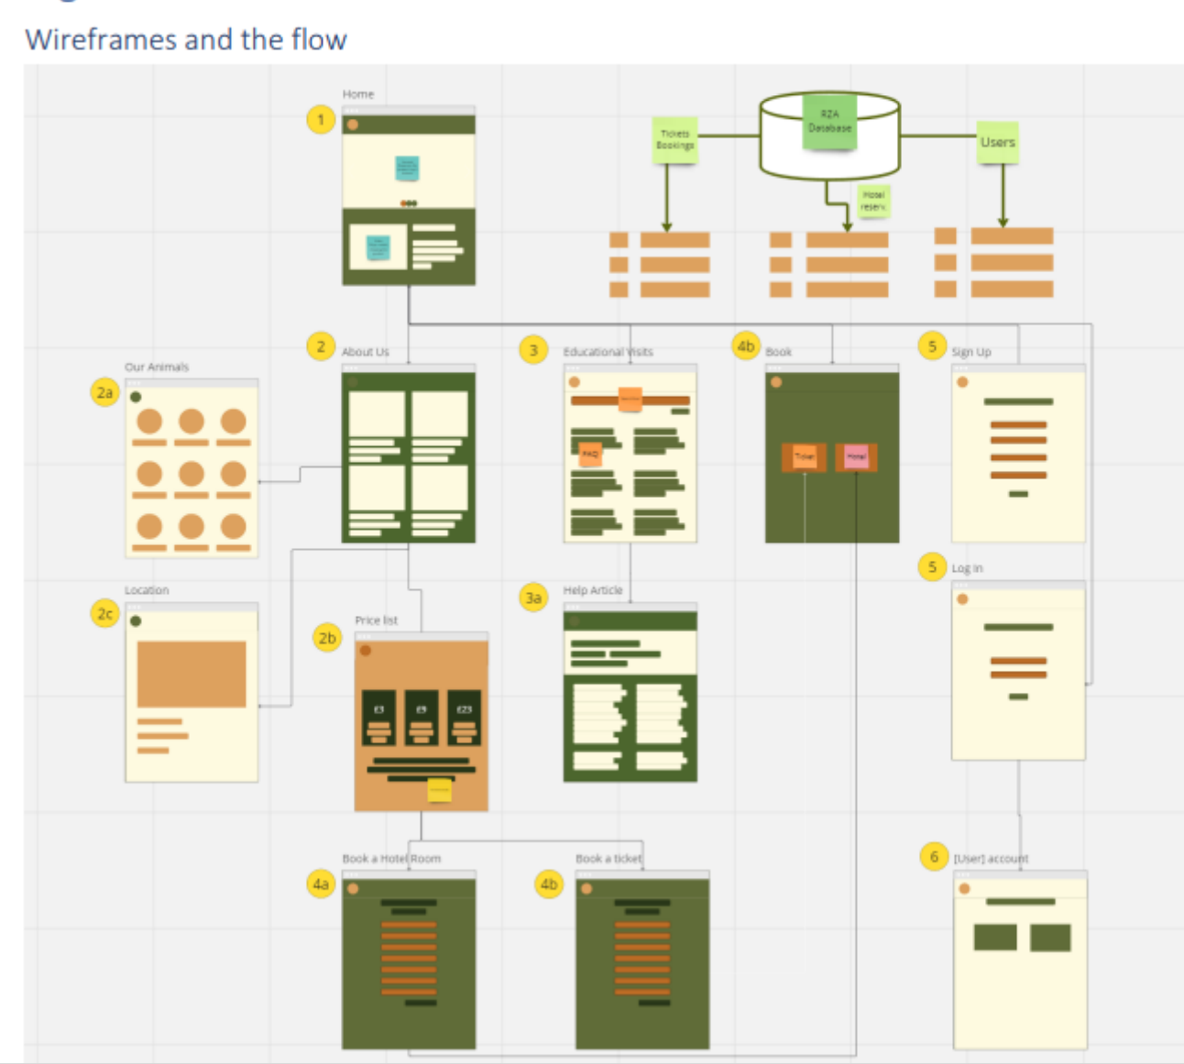
Must show the overall breakdown of the problem. From here, they should select one sub-system and break it down in the next stage, which would be the algorithm using a flowchart or pseudocode as demonstrated

Slide 31
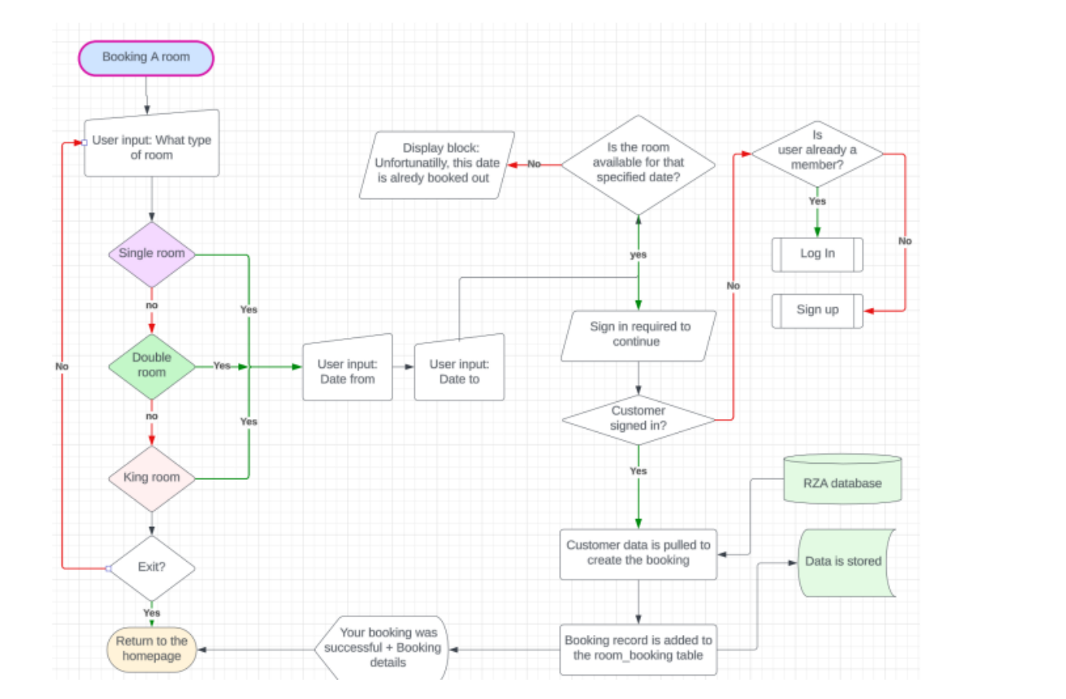
H
Handles various scenarios, including different room types and user statuses (new or existing)
This flowchart detailing the room booking process is a clear, organised, and thorough piece of work
Integrates essential backend processes like room availability checks, user authentication, and data storage in the RZA database

Slide 32
Testing Strategy
Black box testing
White box testing
Functional testing
Integration testing
Unit testing
User acceptance testing

Slide 33
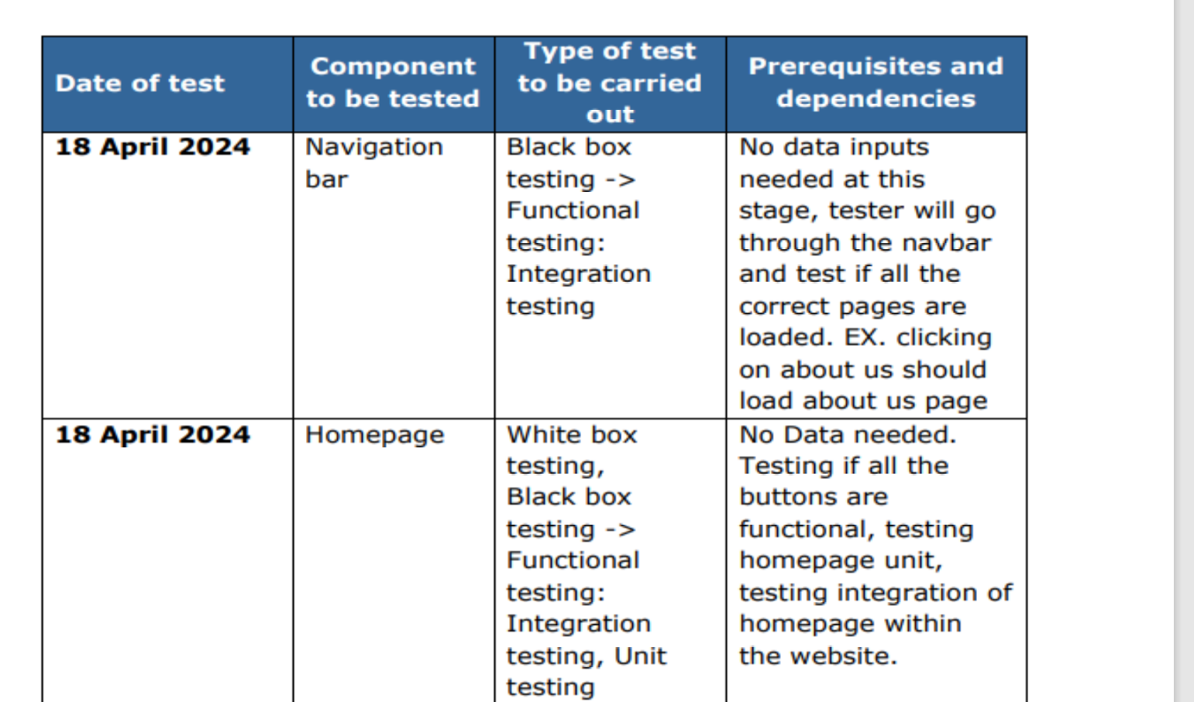
Testing
Well-structured, detailing the components, the type of tests to be conducted, and the prerequisites and dependencies for each test
Each system component, such as the navigation bar, homepage, about page, and educational visits page, is covered, demonstrating a comprehensive approach.

Slide 34
Include White box, black box testing, functional testing, and integration testing
The strategy specifies testing all buttons, the homepage unit, and its integration within the website, showing attention to detail.
Test strategy is comprehensive and well-detailed, covering multiple testing types and ensuring all aspects of the website are thoroughly tested. The clear layout and thorough explanations demonstrate the student’s understanding of testing methodologies and their application,

Slide 35
Technical Implementation
SQL database structure
PHP session management
User authentication system
Dynamic content rendering
Backend validation
API integration

Slide 36
Database Design
Customer table structure
Room booking system
Data relationships
Security measures
Error handling
Performance optimization

Slide 37
Code Quality Measures
Efficient functional code
Multiple language implementation
Input validation
Error message handling
Output verification
Documentation standards

Slide 38
User Experience Evaluation
Survey design
Navigation testing
Visual design feedback
Functionality assessment
User interaction analysis
Performance metrics

Slide 39
Asset Management
Copyright compliance
Source validation
Image optimization
Content relevance
Brand consistency
Resource attribution

Slide 40
Security Implementation
Password encryption
Session management
Data protection
Secure cookies
Input validation
Error handling

Slide 41
Future Development Areas
Content expansion
Payment system integration
Rewards program
Animal API implementation
Live deployment
Performance optimization

Slide 42
Legal and Ethical Considerations
Copyright compliance
Data protection
User privacy
Accessibility standards
Content accuracy
Ethical asset usage

Slide 43
Success Criteria
Functional requirements met
Non-functional requirements achieved
User satisfaction metrics
Performance standards
Security compliance
Accessibility standards

Slide 44
Best Practices for Distinction
Comprehensive documentation
Thorough testing
Clear user focus
Technical proficiency
Ethical considerations
Continuous improvement

Slide 45
Summary and Key Takeaways
Holistic approach to development
Strong technical implementation
User-centered design
Comprehensive testing
Ethical considerations
Future development planning

Slide 46
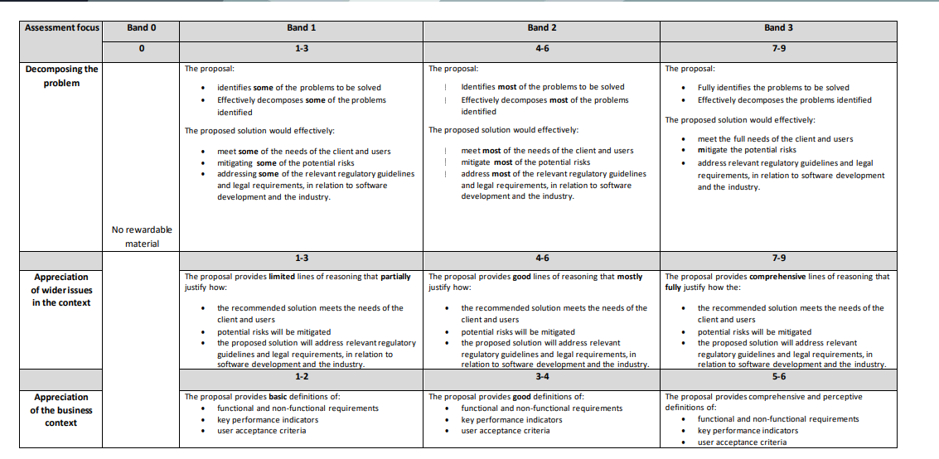
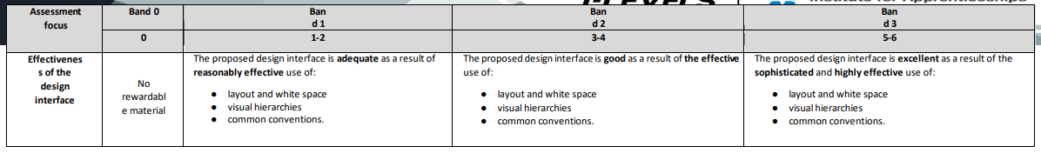
Mark Scheme Task 1A

Slide 47
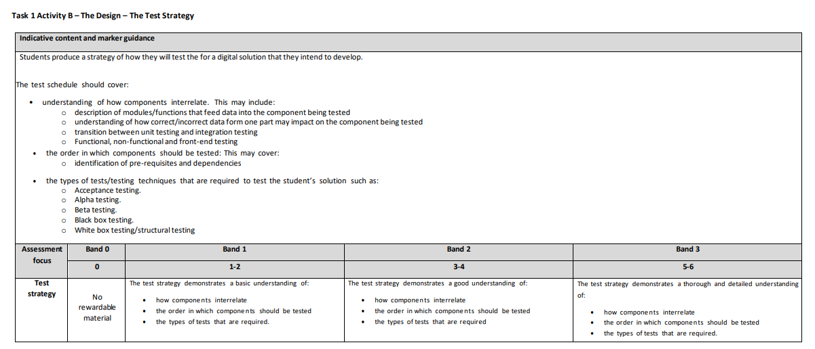
Task 1b

Slide 48
